Slide 1

Writing test case best practices

Slide 2
Test cases are very important for any project as this is the first step in any testing cycle. So, writing test cases which are effective as well as reusable is very important. “What is a Test Case?” A Test Case is simply a list of actions which need to be executed to verify a particular functionality or feature of your application under test. Test Cases are the backbone of every project. Over time, a project will grow to contain a great deal of Test Cases – smaller Test Cases that are frequently needed, and larger Test Cases that can perform sequences or workflows specific to the application.
All about test cases …

Slide 3

- Requirements - Use cases - Design documents
How to write test cases?

Slide 4

- What’s missing? - Will it work? - Will it make sense for the user? - Can I test this? - Can I measure them? - How will I find out if it works? - Are there any contradictions?
How to write test cases?
Analyze the specifications

Slide 5
First read and understand Business requirements get the big picture of what is being achieved from business perspective. Ask for clarifications (BA/MOA/MOE and not the DEV) There can be 1:1 or 1:N or N:1 or N:N relationship between requirements and Test cases Go through Technical specification and UI design document to gain understanding of how the business requirements get translated into application functionality. Also consider verifying the technical aspects mentioned in the Technical docs and look and feel aspects mentioned in UI design documents.
How to write test cases?

Slide 6

Test Case Design
How to optimize test cases?
By using test case development techniques, which are:
Boundary testing;
Equivalence classes;
Decision tables;
State transitional diagrams;
Risk Analysis.

Slide 7

Test Case Design

Slide 8
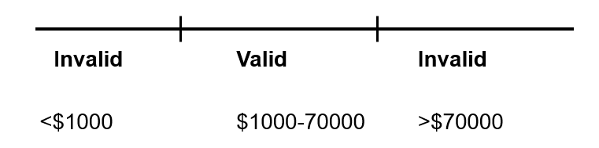
Test Case Design
Equivalence class partitioning
A black box test design technique in which test cases are designed to execute representatives from equivalence partitions. In principle, test cases are designed to cover each partition at least once.
Creates the minimum number of black box tests needed to provide minimum test coverage
Steps:
Identify equivalence classes, the input values which are treated the same by the software:
Valid classes: legal input values;
Invalid classes: illegal or unacceptable input values;
Create a test case for each equivalence class.

Slide 9

Test Case Design
Boundary value
A black box test design technique in which test cases are designed based on boundary values.
Each input is tested at both ends of its valid range(s) and just outside its valid range(s).
Steps:
Create test cases at the boundary of each input:
Just below the boundary;
Just above the boundary;
The focus is on one requirement at a time;
Can be combined across multiple requirements – all valid minimums together, all valid maximums together;

Slide 10
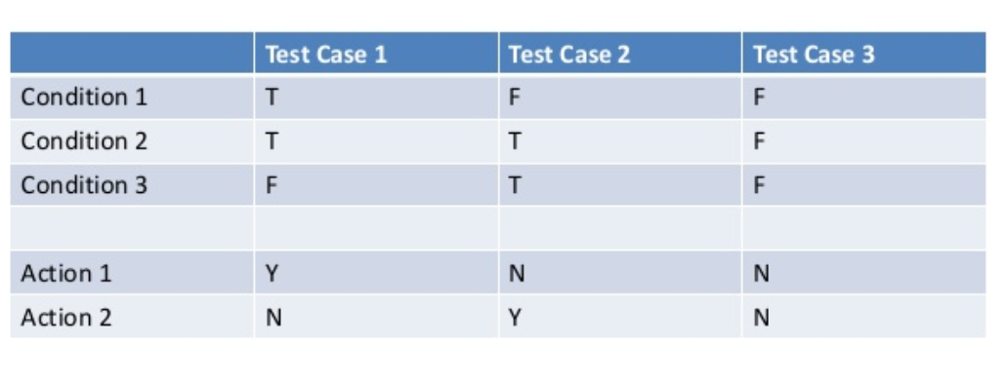
Test Case Design
Decision Table
Useful in systems where combinations of input conditions produce different actions
A way to capture system requirements that contain logical conditions
Relation between cause and effect

Slide 11
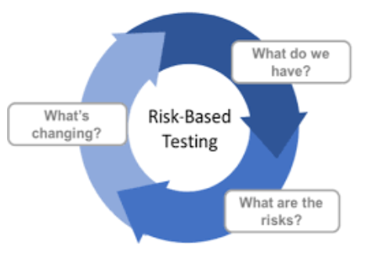
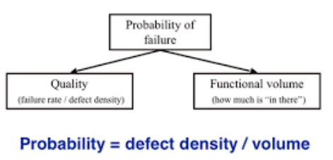
Test Case Design
Risk Analysis
Imagine how the program could fail
Design test cases to expose these potential failures
A way the program could fail

Slide 12

How to write test cases? – Good practices

Slide 13

Tips and Tricks
1. Naming the test cases
- choose meaningful names and be specific
-the name should contain the action or the aim of the Test Case
Ex: “Create a new Risk Event – verify Audit Trail” or “Search Risk Event according to a selected risk type “
2. Keep the Test Steps Clear and Concise
The test steps should include the data and information on how to execute the test.
The steps in the test cases should be detailed & to the point, so new tester can easily execute the test case with ease.
3. Ensure 100% Coverage
-cover all the verification points for feature under test
-write test cases for all software requirements mentioned in the specification document.

Slide 14

Tips and Tricks
4. Be creative and think out of the box
Test cases need to consider a variety of conditions that the software will be expected to handle.
The test case must be able to comprehensively test the software module with almost all possible combinations of main conditions.
The test cases need to reflect the usage patterns and flows. Every test case should try to cover as much of the flow as reasonably possible – going across technical boundaries of the underlying application (Test cases often focus on a specific function)
The test designer should look for the ‘corner-cases’ or ‘boundary conditions.’ and not simply repeat the requirements document into test cases.
Developers tend to assume a straight, logical path from start to finish. In reality, though, end users will take an exponential number of paths, many of them illogical.

Slide 15

Tips and Tricks
5. Avoid assumptions
If there are missing steps in the test cases, then it leaves gaps for the developer/tester, causing them make assumptions when executing test cases. This can cause inaccurate test case execution and important scenarios to be missed.
6. Use brainstorming when defining the test cases
A) After reading the requirements, pick up a Pen & a Paper and write as many scenarios you can write within 5 minutes. It helps because:
- you don’t focus on writing the details of the test cases (this will be a future step)
- you can quickly see if you have any question regarding the business (un-clear specification)
B) keep in mind a similar application which you have used in past. Doing this will let you identify such issues which are not related to requirements but represent a common/generic feature which should be present in the application but has got overlooked.

Slide 16
Test Cases creation (exercise)

Slide 17
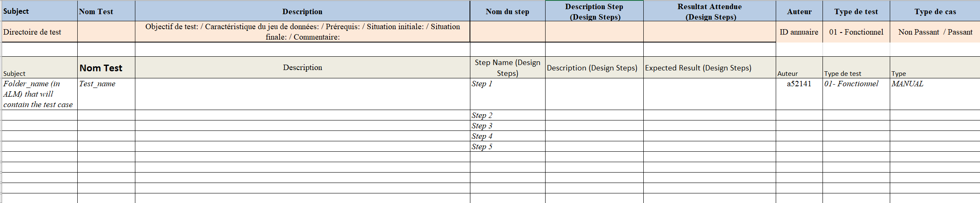
Test plan – Template ALM

Slide 18
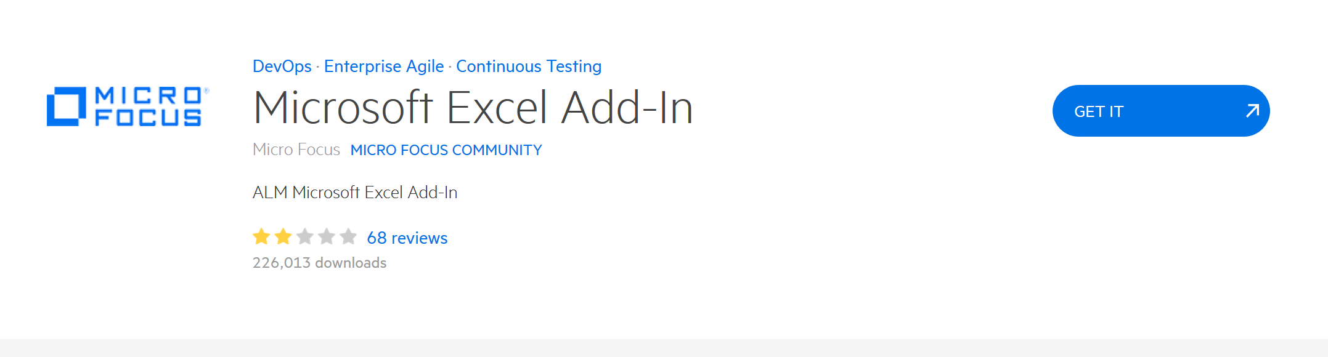
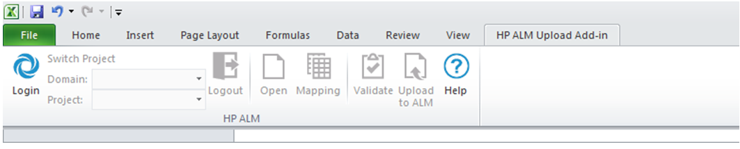
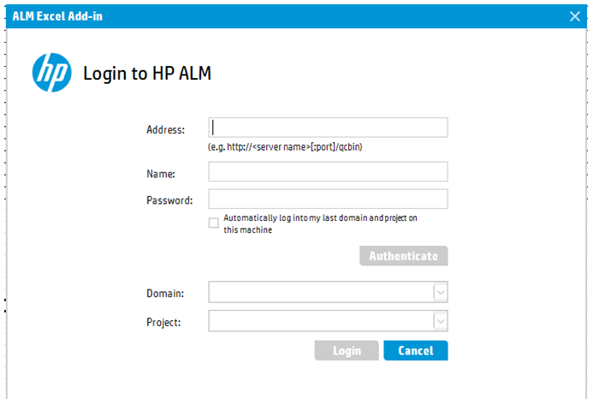
ALM import – Excel add-in (VM)
Steps:
Download plug-in:
https://marketplace.microfocus.com/appdelivery/content/microsoft-excel-add
2) Install plug-in
After that, it can be seen as a new tab in Excel
3) Click on Log in – will open an ALM page to introduce user + password and to choose the domain/project where you want to upload the test cases

Slide 19
ALM import – Excel add-in (VM)
4) Click on the “Mapping” button and choose from My Computer the file “ALM Mapping.tst” (attached in this slide)
5) Select the test cases to be uploaded. Click on the button “Validate”
6) If everything is ok and the validation has passed, click on the button “Upload to ALM”.
Remark: In ALM the tests uploaded can be found in Test Plan part, in the folder whose name corresponds to the “Subject” column in the Excel template

Slide 20
ALM import – test plan (exercise)

Slide 21

Thank you and…

